Slide 1
Video Processing Project
Submitted By: Daniel Mor & Brian Gordon

Slide 2
Video stabilization overview
On this part in order to stabilize the video we used an algorithm based on optical flow principals (as learned in class).
The algorithm performs the following procedure:
For each frame we find points of interest using “Harris Corner Detector” (cv2.goodFeaturesToTrack)
Calculate optimal projective transformations which describe best the transformations between frame and it’s next frame. (We chose projective transformation since 2D affine transformation wasn’t enough to describe the motion in the video, for this step we used cv2.calcOpticalFlowPyrLK and cv2.findHomography functions)
We smooth the transformations using Moving Average filter in order to reduce noise and make transitions smoother.
Finally, we create our stabilized video warping each frame using the smoothed transformations. (cv2.warpPerspective)

Slide 3
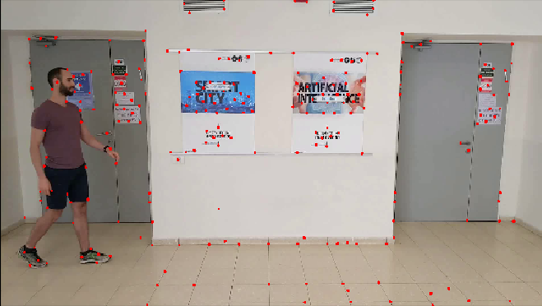
Video stabilization
Points of interest using Harris Corner Detector

Slide 4
Background subtraction
During our project we work with 2 different approaches for the background subtraction part.
In the first approach we slightly overfit since we finished the whole project before the overfit instructions were redefined. Yet, even thought our final code is not using this approach, we find it important to elaborate on this approach since we rely on its main prinicipals at the second approach.
In the 2nd approach we do not overfit and we get even better perfomance both in terms of background subtraction and time complexitiy.

Slide 5
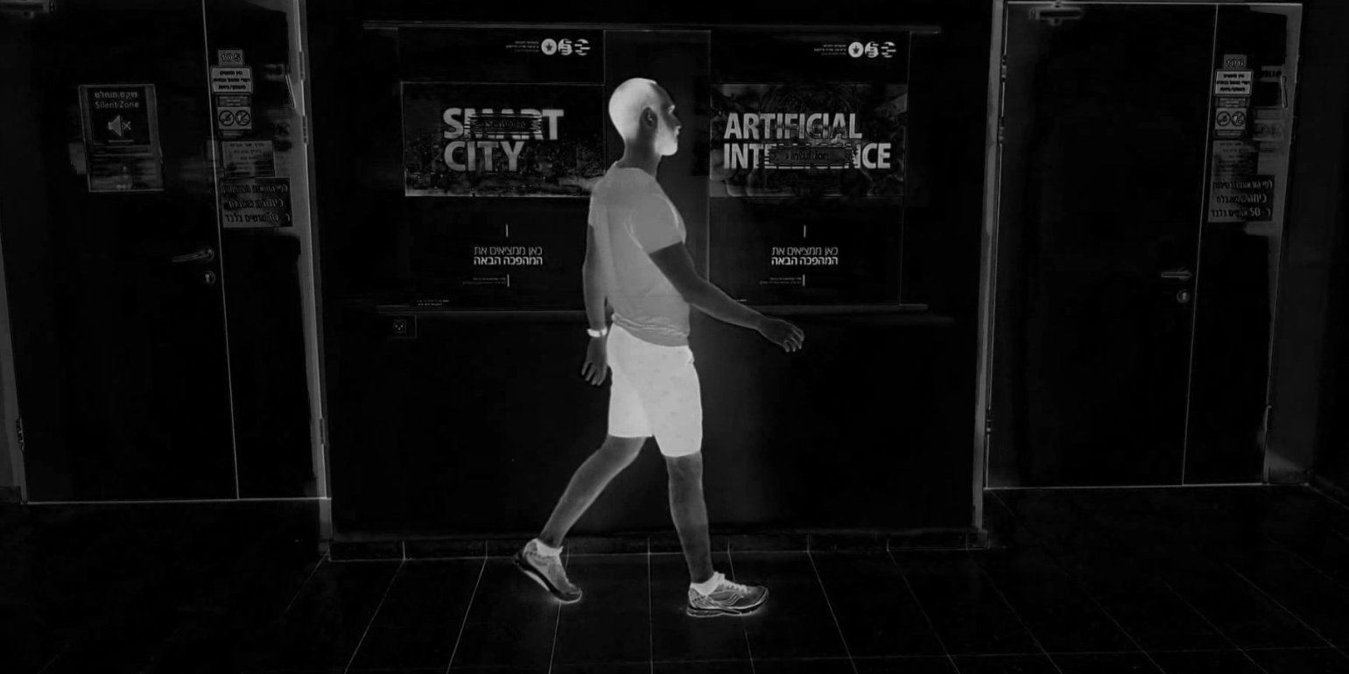
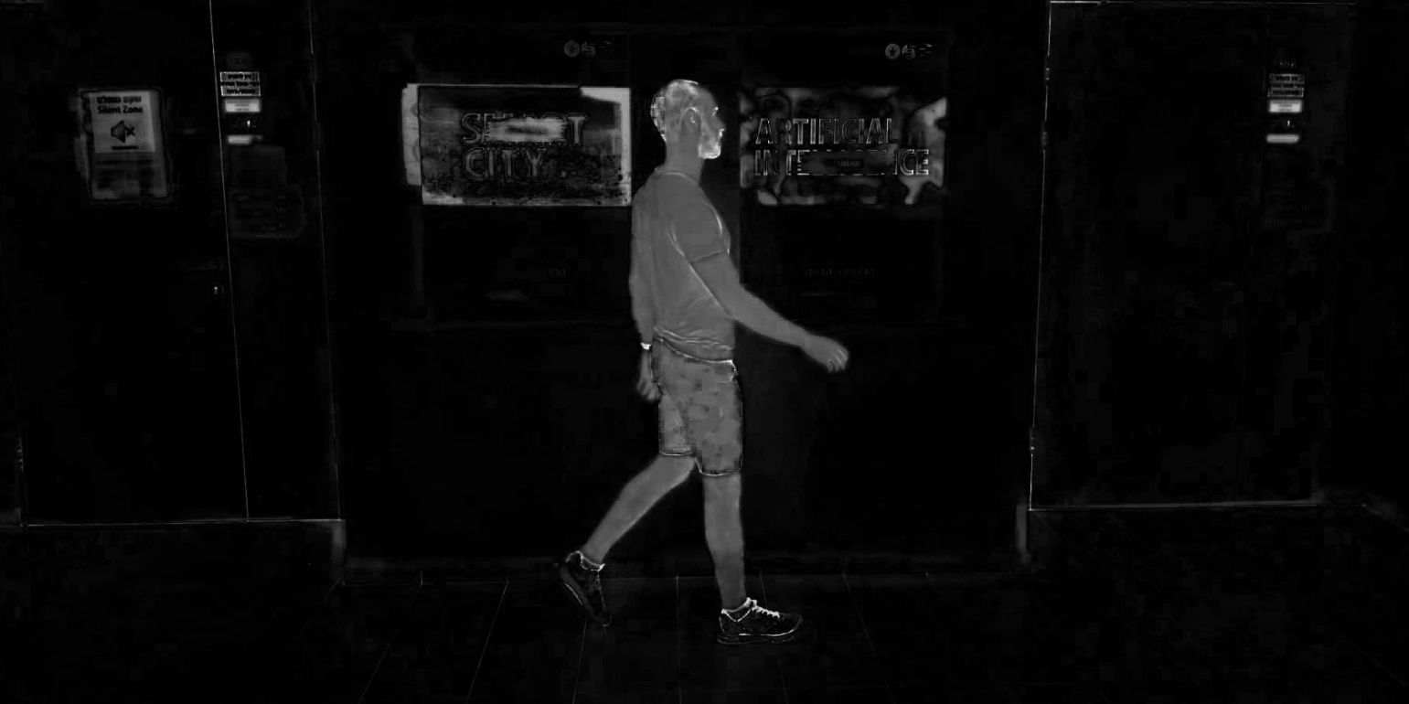
BACKGROUND subtraction - first approach
On this part in order to subtract the background we followed this procedure:
For initial filtering we analyzed different color spaces and their medians across time. The idea was to define foreground pixels to be the pixels that their intensity values are higher than their median intensity.
We find that using HSV color space and applying median filter as described on the S & V channels results as a decent initial filtering.
V channel – Diff from median
S channel – Diff from median

Slide 6
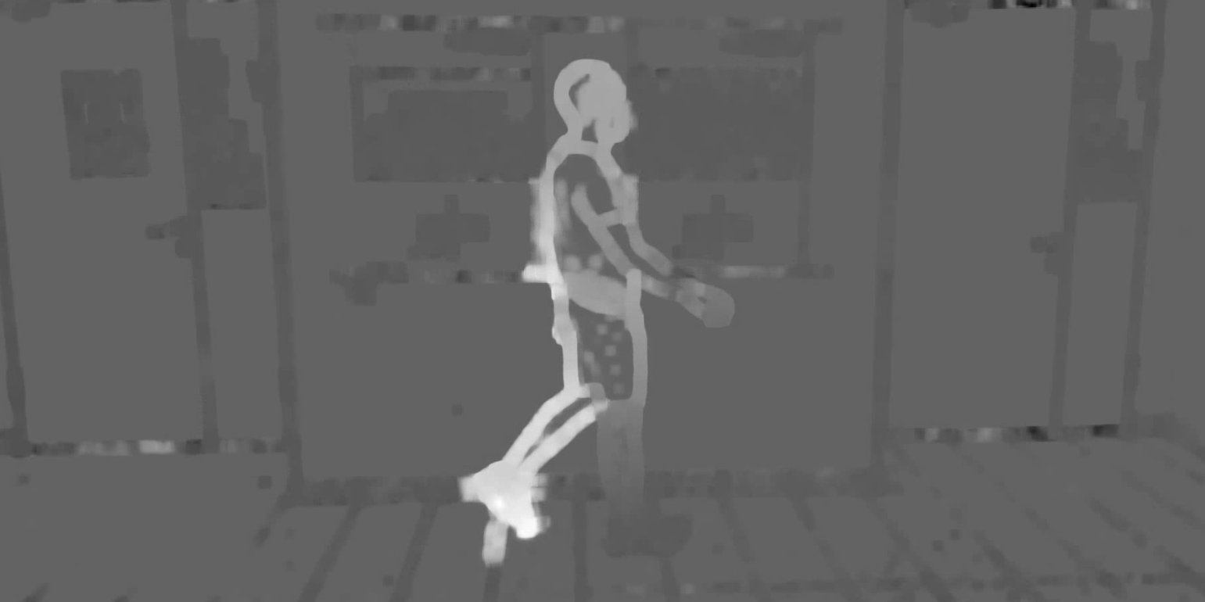
BACKGROUND subtraction - first approach
For further filtering we tried to differentiate the person from the background based on it’s horizontal velocity. We computed for each pixel and frame it’s optical flow, we then tried to cluster the pixels in to 2 clusters based on their horizontal velocity (using K-means algorithm).
Unfortunately, we got poor results both in terms of time complexity and cluster performance as shown in the following picture.
Horizontal velocity frame.
As we can see it’s hard to make a good separation on specific parts of the body (i.e. right foot) since different
parts of the body change their velocity frequently in the video

Slide 7
BACKGROUND subtraction - first approach
After we failed to differentiate the person from background using clustering based on horizontal velocity, we tried to differentiate the person by calculating a representative pdf both for the person and the background following this procedure:
(Note: In this part we did some kind of overfitting (But as we said this is not our final approach)
- We chose some frame after S&V median filtering as a representative mask
- We eroded dramatically the mask in order to get color samples from the person only.
We used those samples in order to build a pdf representation of the person (Using gaussian KDE), the same process has been done for the background.
After having both pdfs we computed for each pixel in each frame it’s probability of being a foreground or background pixel.
Pixel was defined as a foreground pixel if it’s foreground probability was higher than it’s background probability. (Naïve base) (Note: in order to optimize the performance we used memoization. Since probability is defined only by pixel color, it’s sufficient to calculate each color probability once. So instead of calculating probabilities for 2M pixels in each frame, we computed only 150K color values).

Slide 8
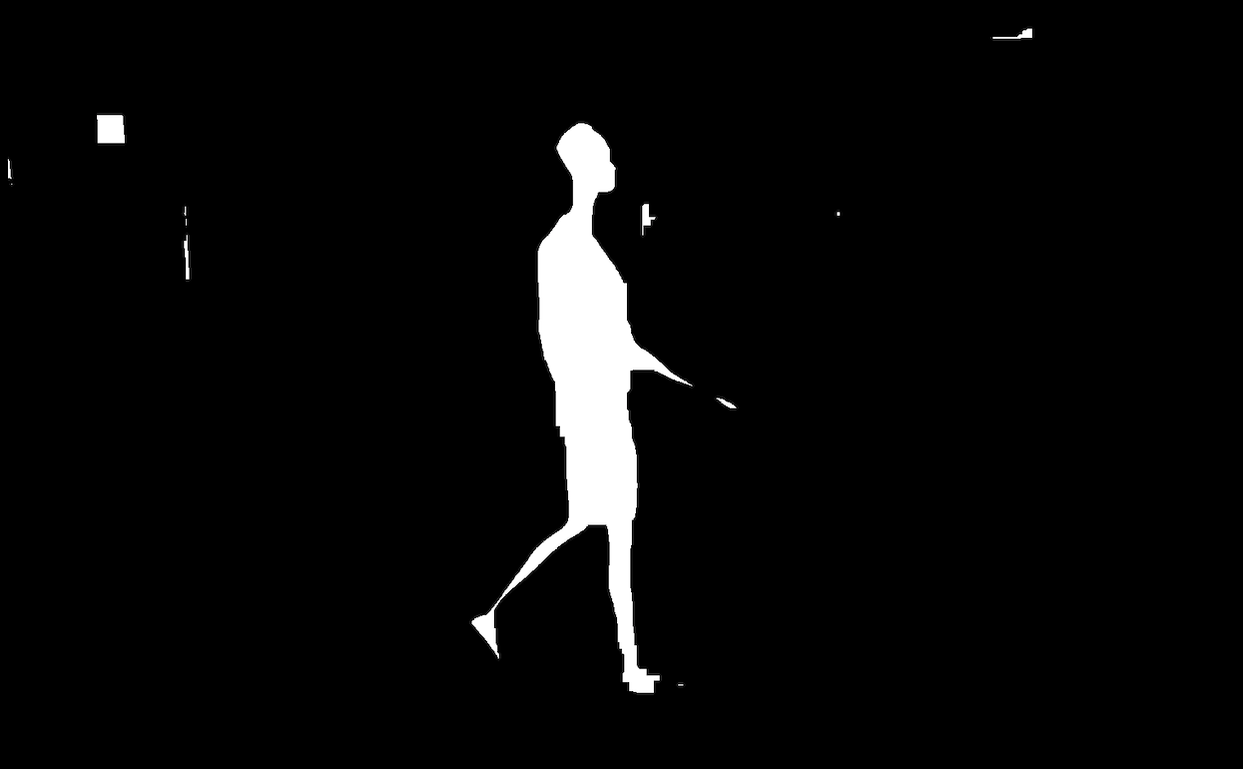
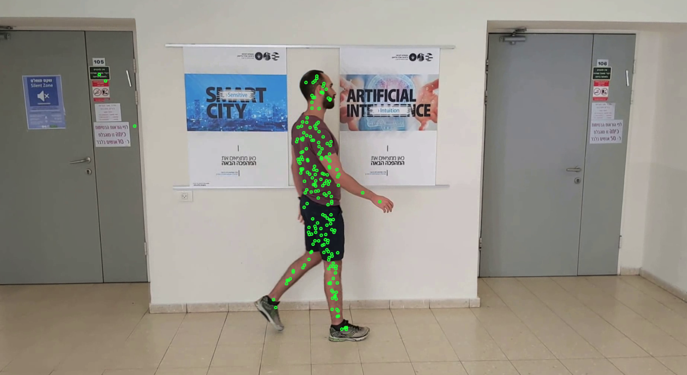
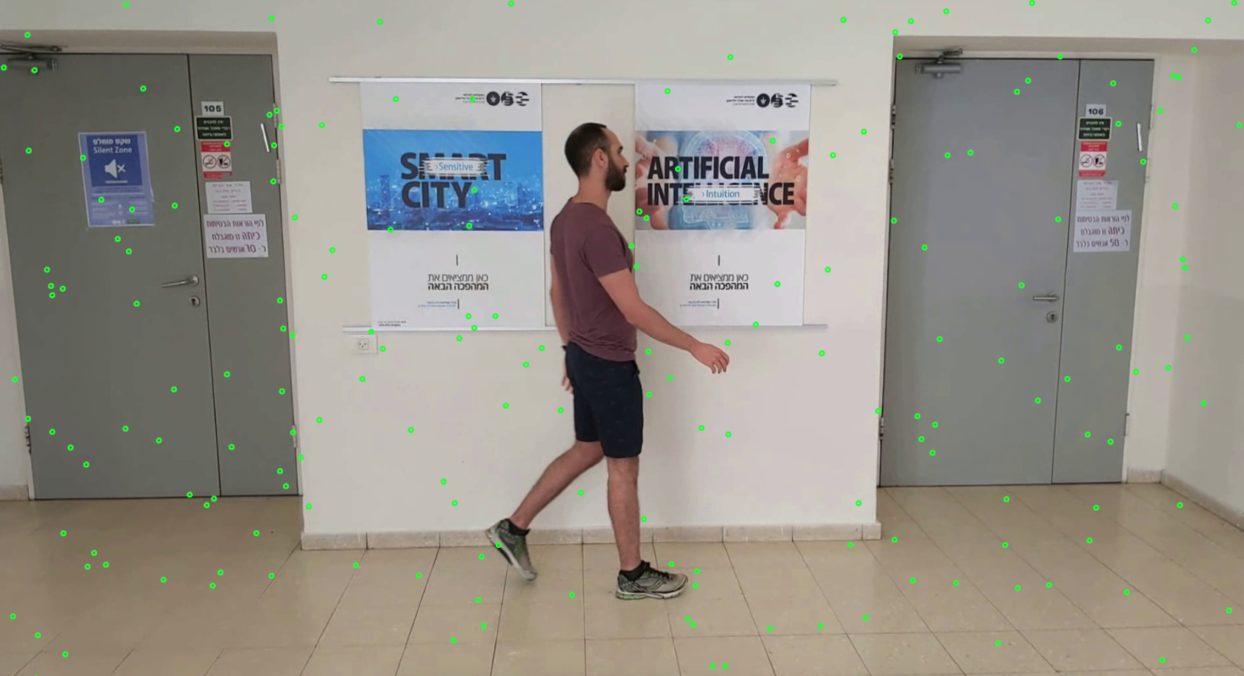
Mask for sampling person and background colors
for building representing pdfs
Color samples taken for building person pdf
Color samples taken for building background pdf

Slide 9
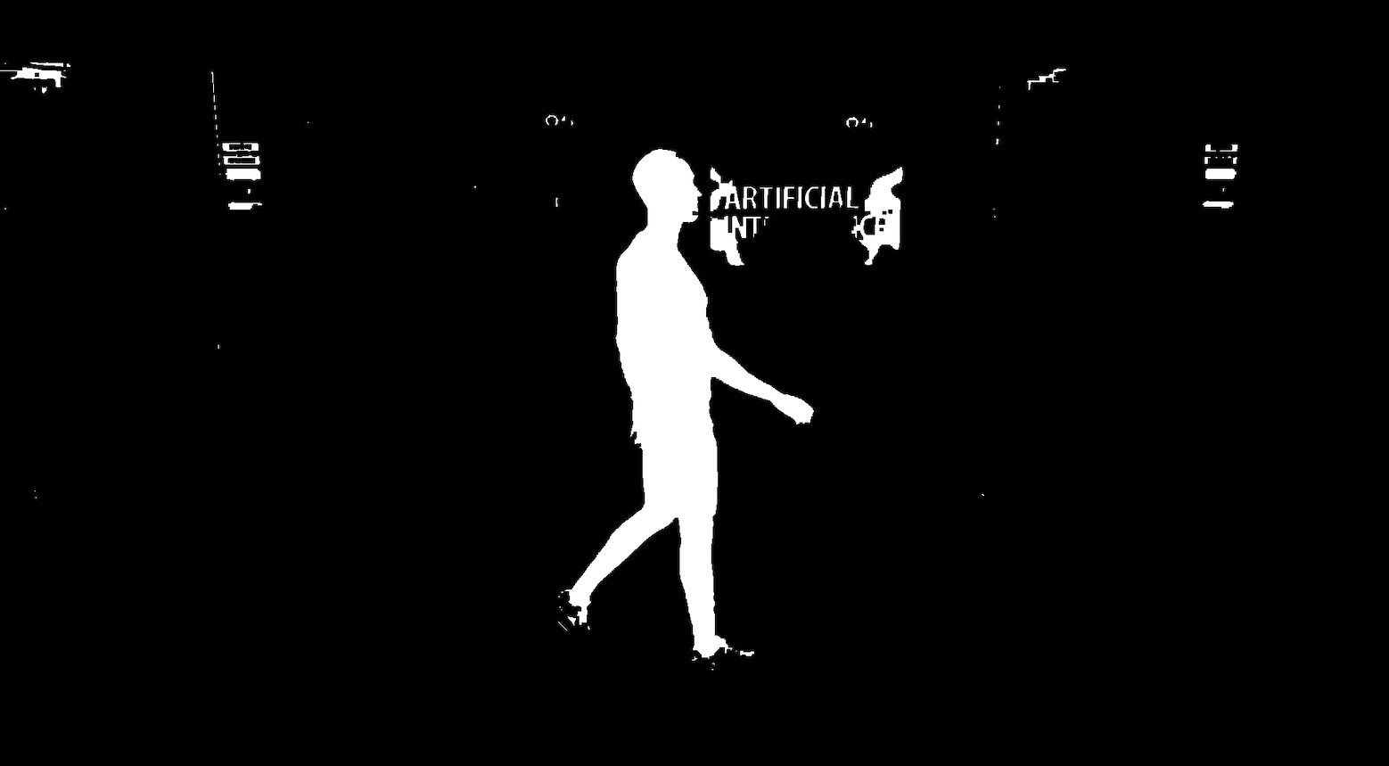
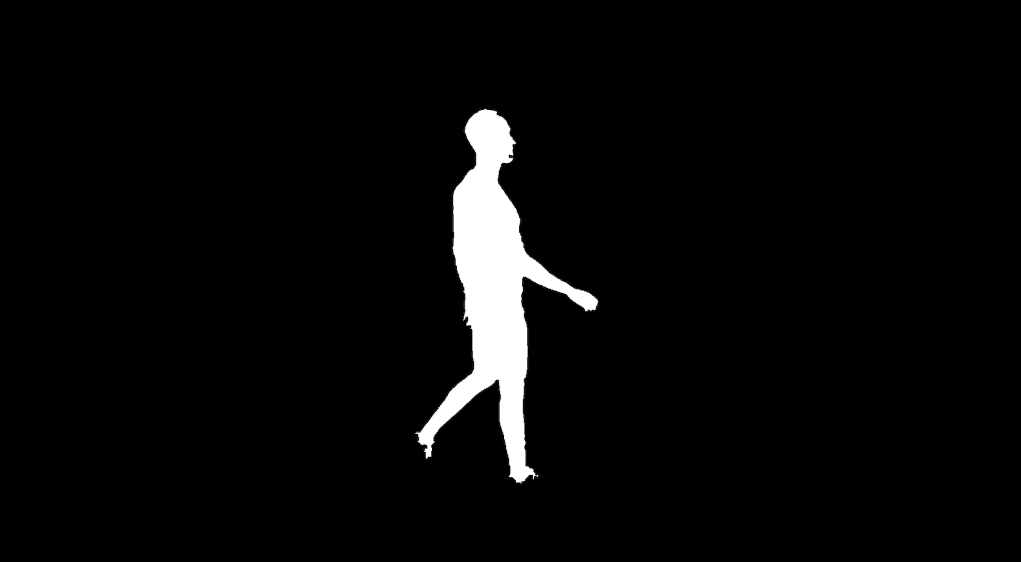
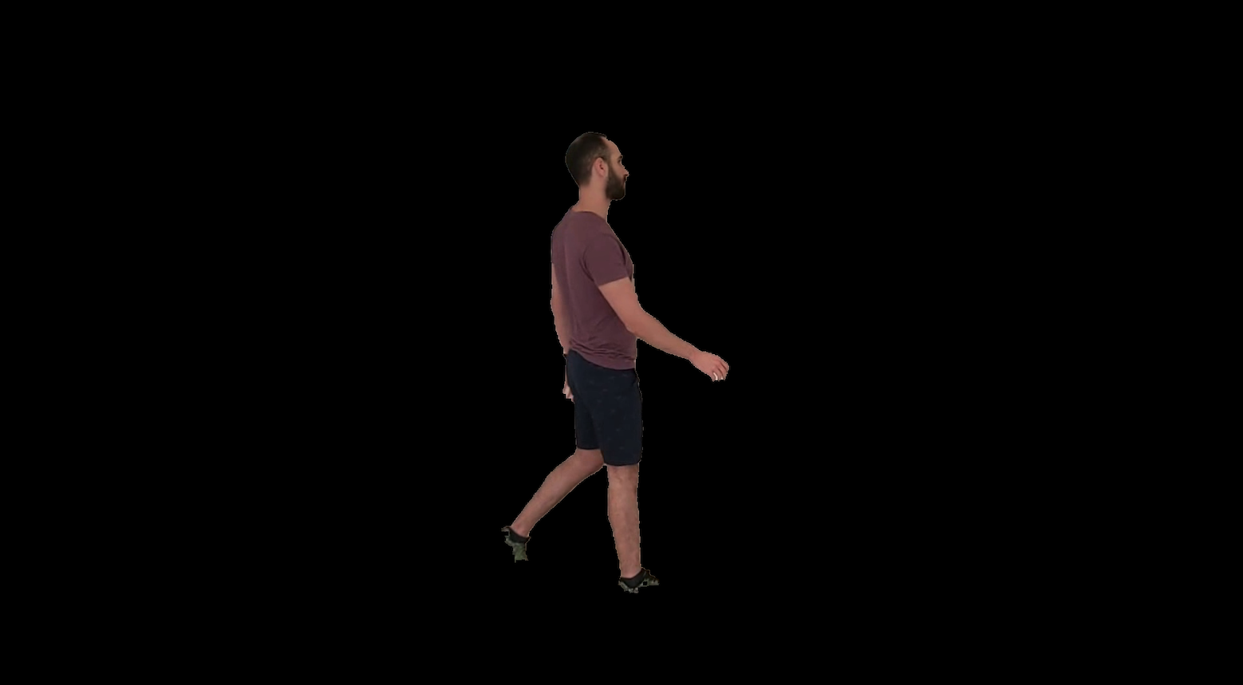
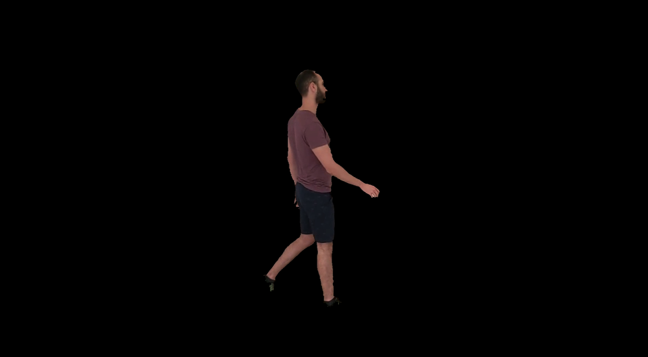
מסכה נטו על הסתברות הקי-די-אי (אחרי פעולות מורפולוגיות)
רק הקונטואור
אותה תמונה כמו למעלה, אבל בצבע
אחרי fine tune על הקונטואור

Slide 10
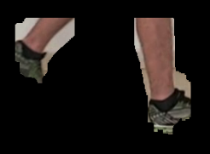
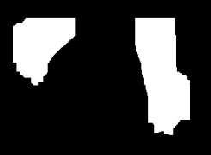
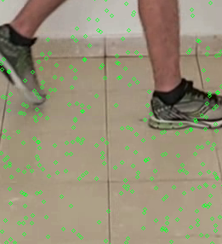
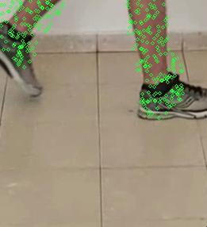
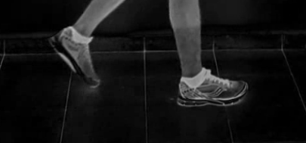
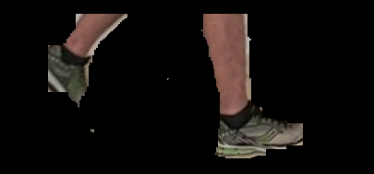
הקונטור שעבר השמנה
תמונה של ערוץ צבע ירוק (הפרש מהמדיין) - חותך שוקיים
תוצאה סופית

Slide 11
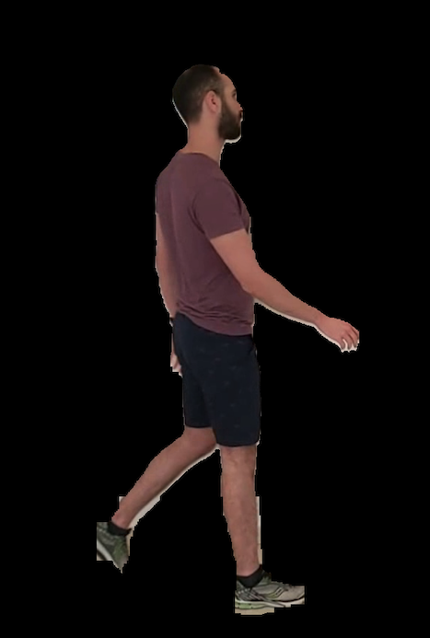
לפני ואחרי שיפור נעליים

Slide 12
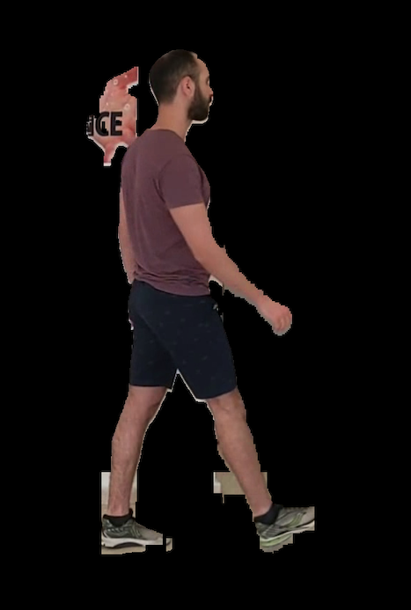
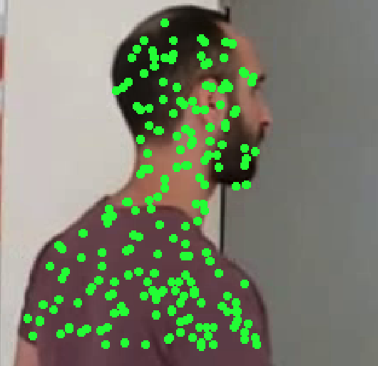
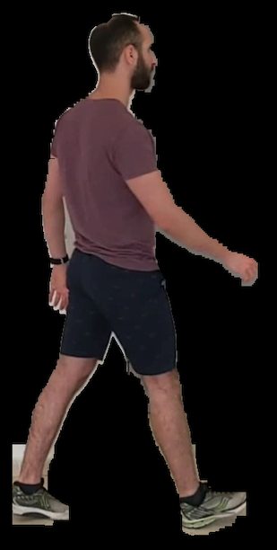
הגרלות בשביל בניה של קי-די-אי
בעיה, הצבע של השלט ממש דומה לבן אדם
אחרי תיקון
כאן, לא נעשה שימוש בהסתברות רקע, רק לקחנו pdf מומחה בן אדם, ובדקנו מה הוא אומר על הפיקסלים במלבן הנתון, אין מאיפה להביא פיקסלים רקע כי המטרה העיקרית כאן זה בדיוק לבטל את ה false positives של הבן אדם.

Slide 13
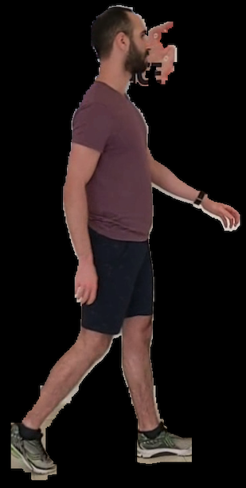
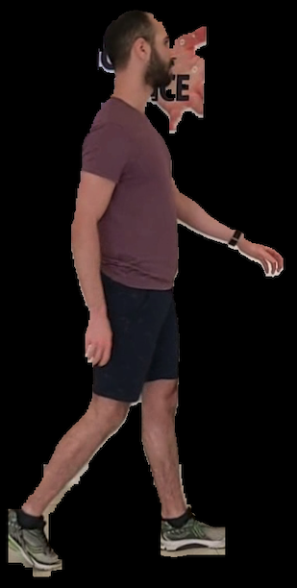
מקרה שתיקון פנים לא עזר

Slide 14
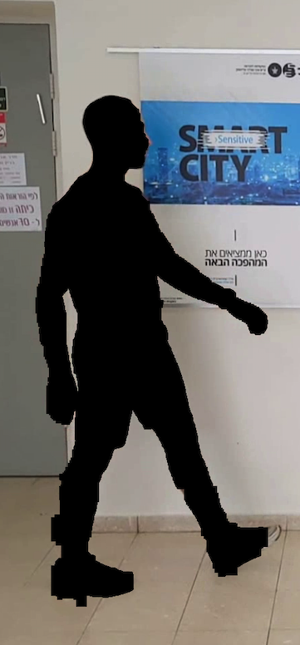
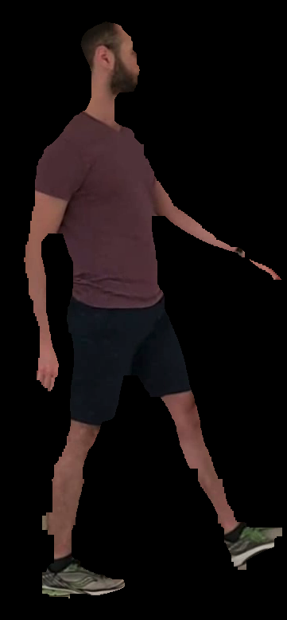
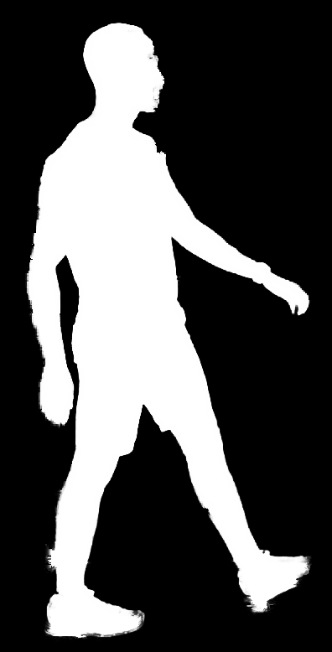
MATTING
Omega F
Undecided zone
Alpha map
# BW 1 has been chosen to receive a general map of the colors of ba
OMEGA B

Slide 16
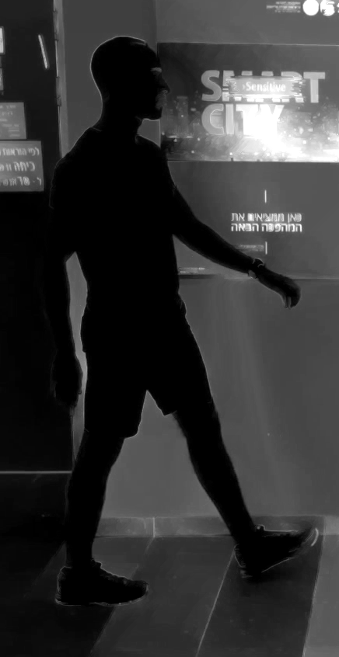
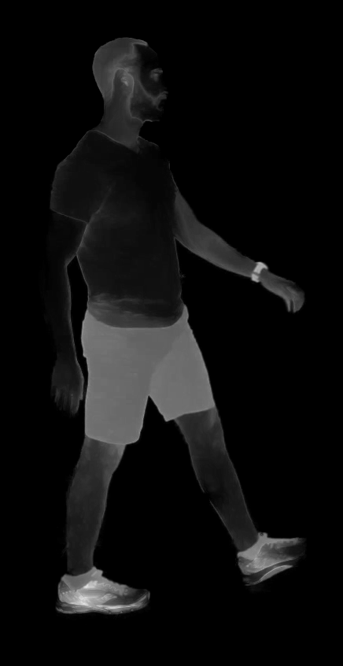
Background dist map
After matting
Foreground dist map

Slide 17
MATTING – SHOW TREE DECISION

Slide 18
CUSTOM NARROW BAND - CUSTOM ALPHA – NAIVE
ולכן בסט קאפל ירד מהפרק
CUSTOM NARROW BAND - CUSTOM ALPHA – BEST COUPLE

Slide 19
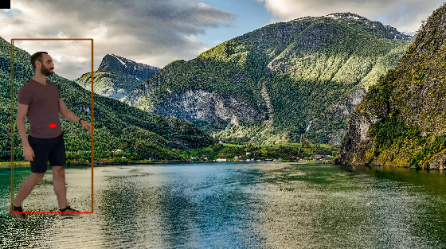
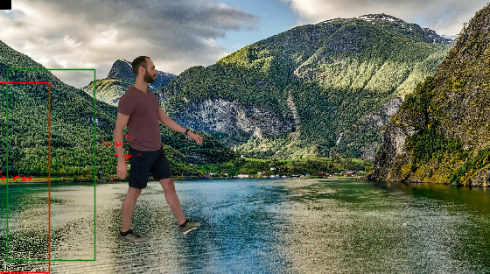
tracking
Particle filter

Slide 20
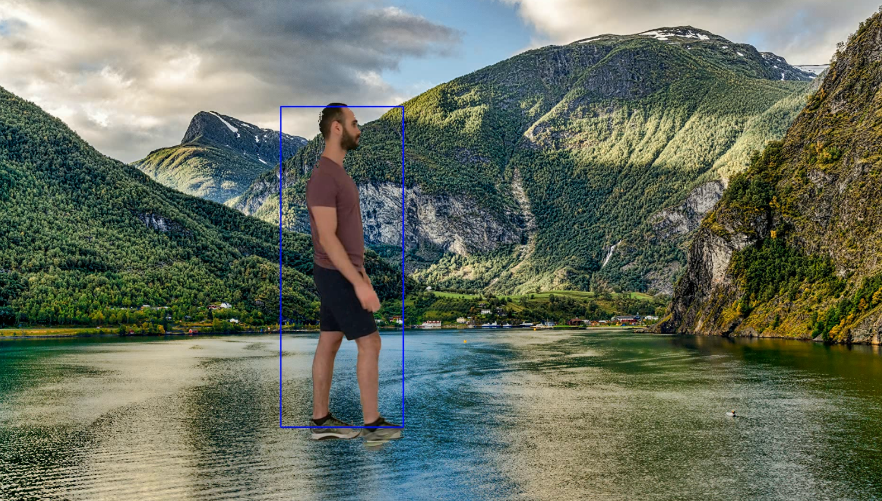
tracking

